Slide 1
Welcome to Gettysburg Hospital
Provider Orientation Information

Slide 2


Slide 3
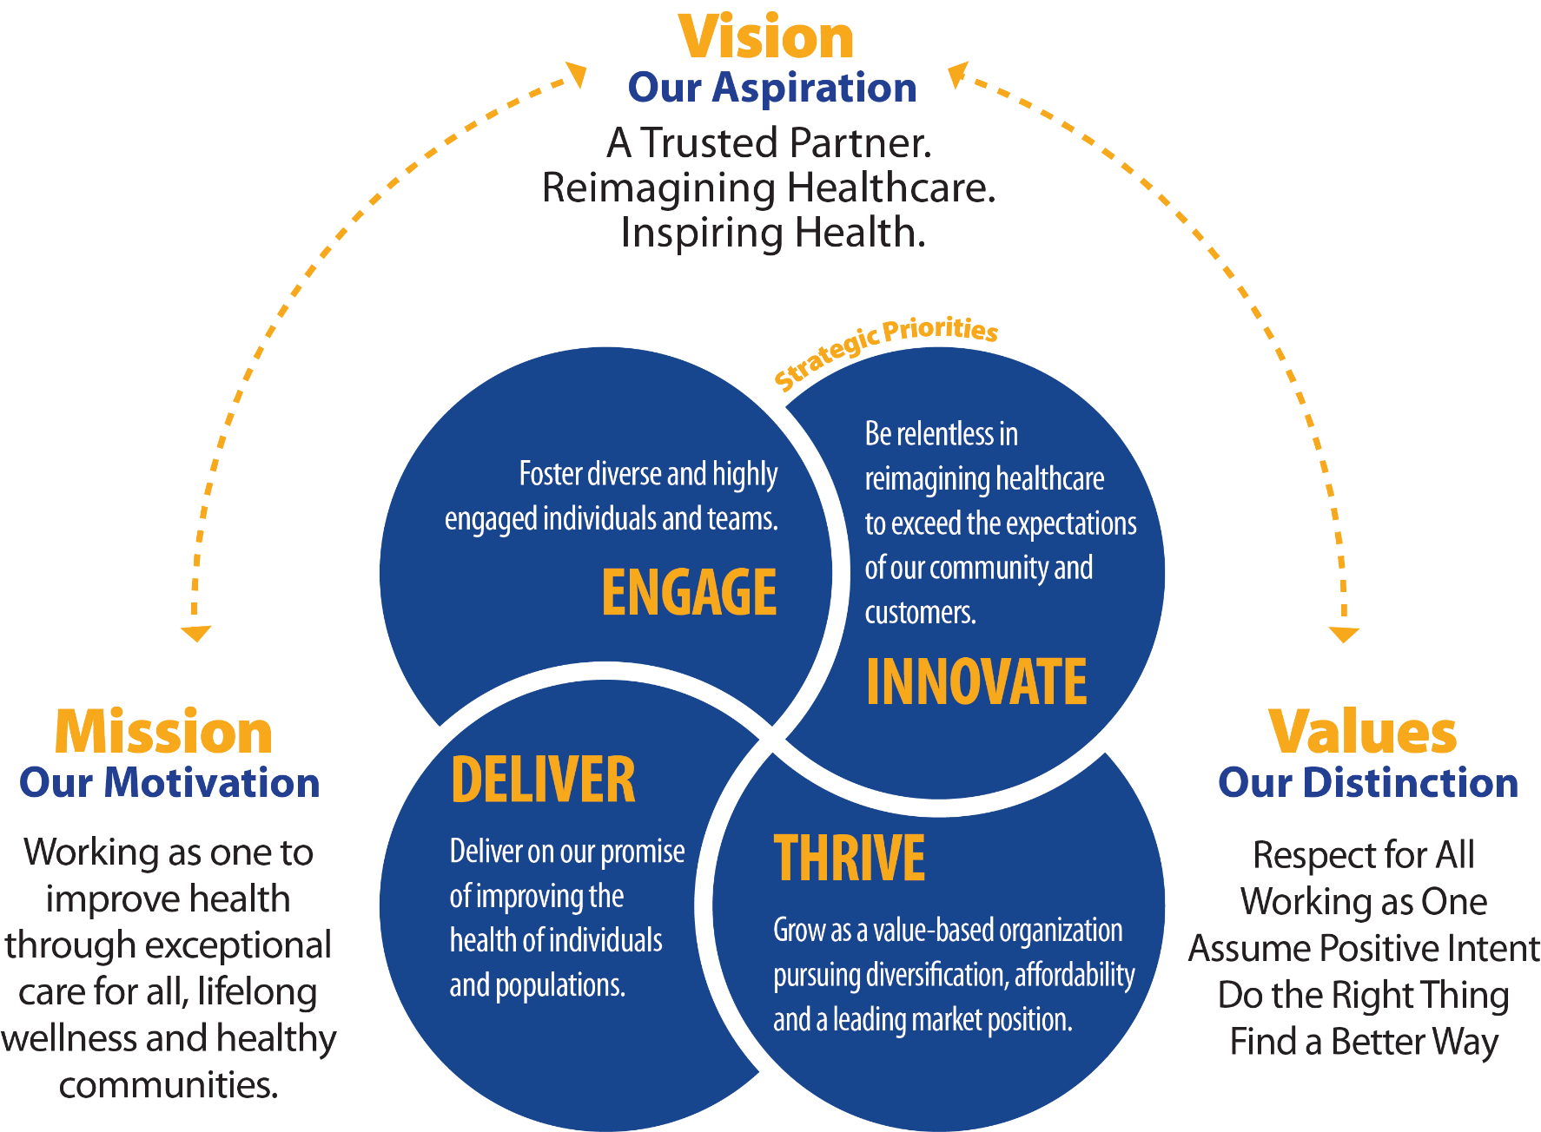
4

Slide 4
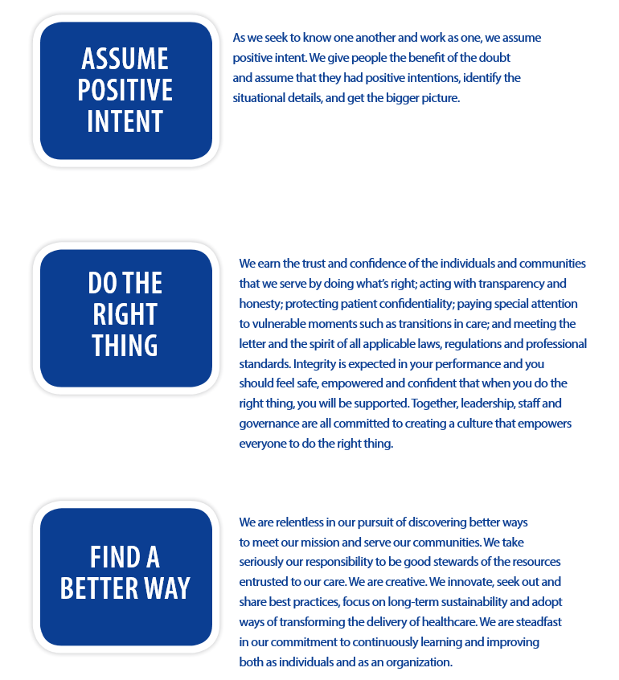

Slide 5
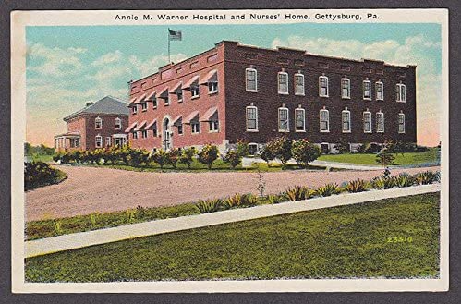
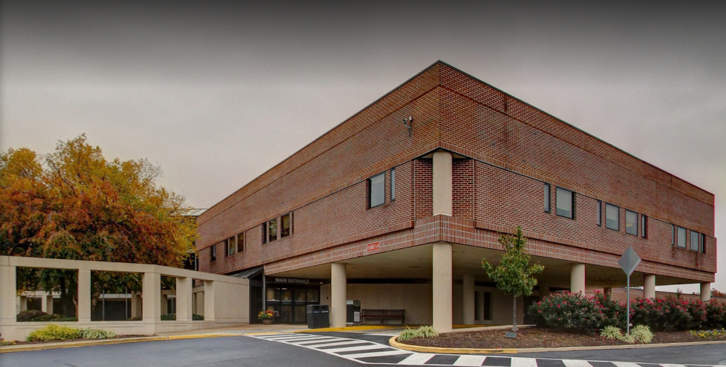
Wellspan Gettysburg Hospital
Notes:
5

Slide 6
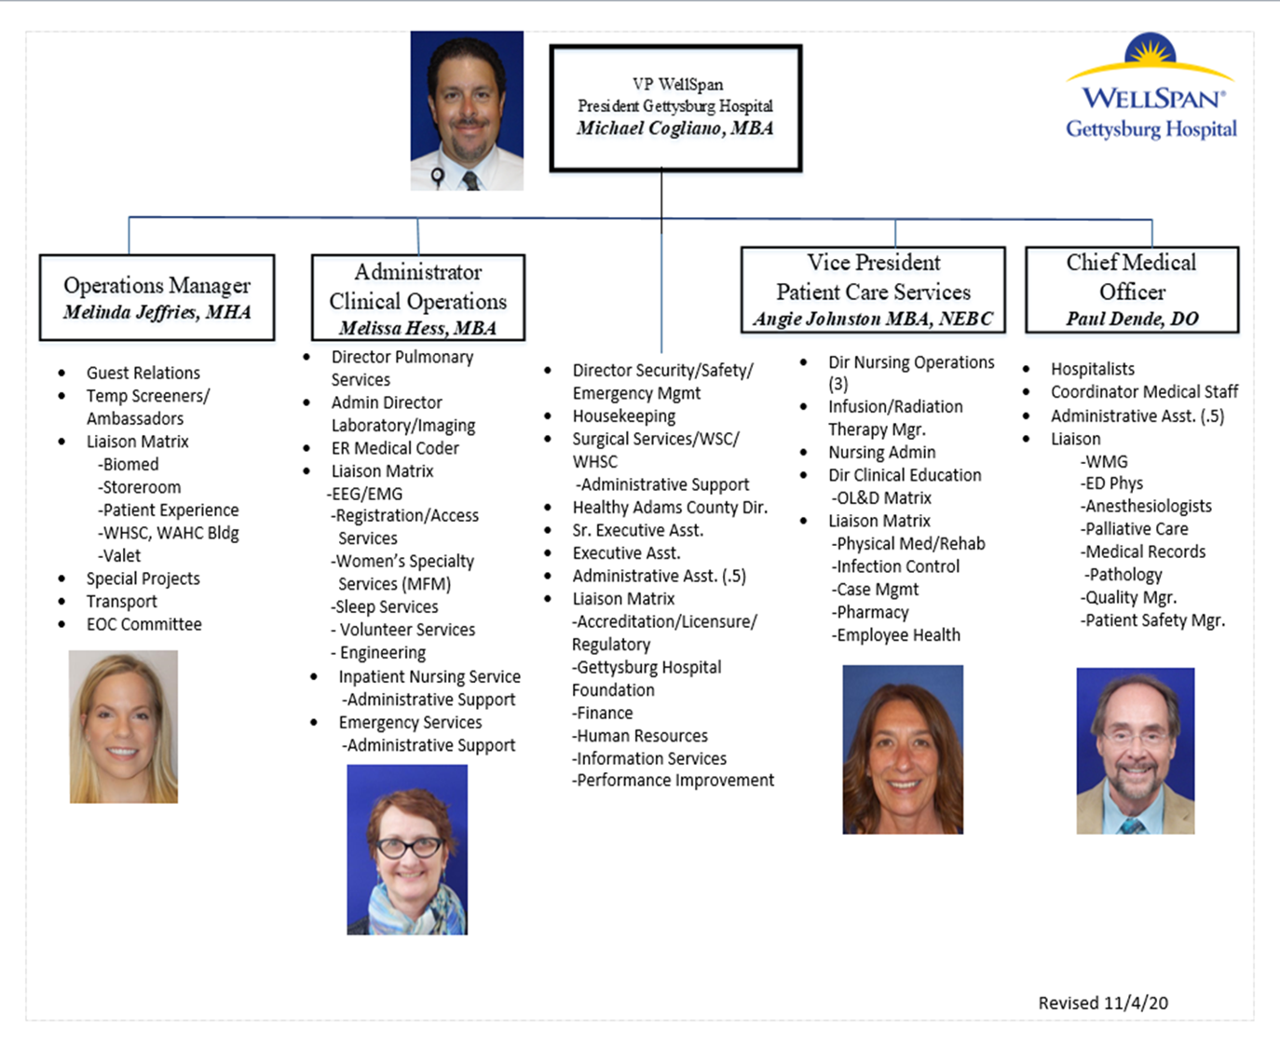

Slide 7


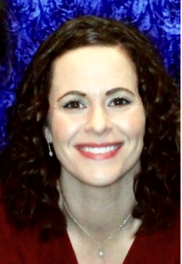
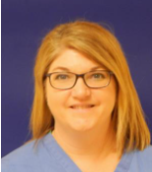
Accreditation, Quality & Safety
Kristi Eiker, Manager of Quality Improvement
Jen Owings, Manager of Accreditation and Licensure
Jennifer Lang, Patient Safety Officer

Slide 8
Accreditation
Det Norske Veritas – Germanischer Lloyd (DNV-GL)
  Includes the entire hospital and offsites under Gettysburg Hospital’s licensure
  Annual and unannounced surveys
  Gettysburg is also certified by DNV-GL as a Primary Stroke program

Slide 9



DNV-GL Accreditation Continued …
Standards are called National Integrated Accreditation for Healthcare Organizations (NIAHO ®)
CMS Conditions of Participation for Hospitals
ISO 9001 Quality Management System requirements

Slide 10

What is ISO?
ISO: the organization (International Organization for Standardization)
  A network of 163 member countries
  Focused on International standards
ISO = the standards (9001:2015)
  A minimum set of quality standards
  Not Healthcare specific: Applicable to all types of organizations
  Not very prescriptive

Slide 11
Your Role in ISO 9001
Customer Focus
Recognize your direct and indirect customers: patients, families, visitors, co-workers, supervisors, other departments
Understand their needs and expectations
Be aware of your patient satisfaction scores from Press Ganey
Ensure new processes are designed with the patient in the center
Leadership
Know the organization’s mission, vision, strategies, policies and processes throughout the organization
Be committed to quality – SPEAK UP if you see any issue

Slide 12
Your role continued …
Engagement of People
Promote collaboration throughout the organization
Identify opportunities for improvement in your department and WGH
Work with your supervisor/manager to create goals to facilitate your personal and professional development
Complete the Employee Engagement Surveys from WellSpan
Process approach
Know if workflows or standard work have been created for the work you do
Follow the workflows or standard work
If you identify an issue/difference between your practice/work and the workflow – SPEAK UP
Let your supervisor/manager know if there is a process that needs to have standard work created

Slide 13
Your role continued …
Improvement
SPEAK UP when you see an opportunity for improvement
Participate in department huddles
Be a problem solver
Evidence-based decision making
Ask to see the data/metrics from your department
Use the data to drive process improvement
Relationship management
Share concerns or satisfaction with vendors, suppliers

Slide 14
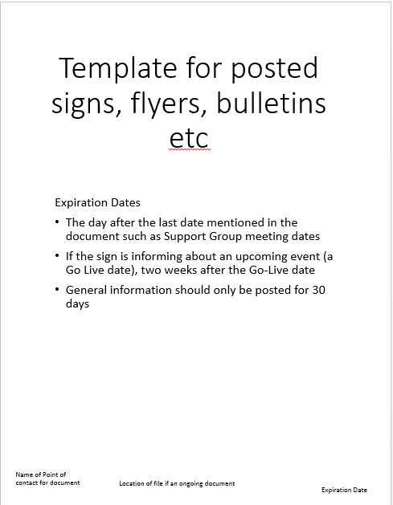
Your role continued …
Control of Documents
  Put expiration dates on any created materials
  Toss posted materials that are expired
  Do not keep copies of printed policies
    Print → Use → Discard DO NOT HOARD PRINTED DOCUMENTS
    Ensure you are using the most current version of the document, form etc.
Notify supervisors/managers of any identified defects (any where)
  Complete SRS report when you identify an unexpected occurrence or event
  Bring the issue up at your department huddles (Heads Up, Speak Up)

Slide 15
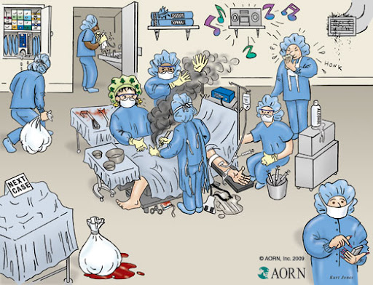
Patient Safety – Act 13
Notes:
Switching topics. This picture represents many different bad practices. How many can you see?

Slide 16

Definitions in Act 13
Health Care Worker: An employee, independent contractor, licensee or other individual authorized to provide services in a medical facility
Incident: An event, occurrence or situation involving the clinical care of a patient in a medical facility which could have injured the patient but did not either cause an unanticipated injury or require the delivery of additional health care services to the patient. The term does not include a serious event.
Infrastructure failure: An undesirable or unintended event, occurrence or situation involving the infrastructure of a medical facility or the discontinuation or significant disruption of a service which could seriously compromise patient safety.
Serious Event: An event, occurrence or situation involving the clinical care of a patient in a medical facility that results in death or compromises patient safety and results in an unanticipated injury requiring the delivery of additional health care services to the patient. The term does not include an incident.

Slide 17
Requirements of Act 13
Patient Safety Officer – Jen Lang.
Patient Safety Committee
    First Tuesday of every month.
Open to anyone who wants to come.
System to report serious events and incidents that is accessible 24/7 – Safety Reporting System (SRS). Found on the INET.
No retaliatory action against a health care worker for reporting a serious event of incident.
Written notification to the patients/family.

Slide 18
Reporting
Event Reports are to be made immediately or as soon as reasonably practicable.
MUST be NO later than 24 hours after the occurrence or discovery of a serious event of incident.
If you are not sure what to do, call Jen Lang.
Desk phone (717) 337-4252.

Slide 19
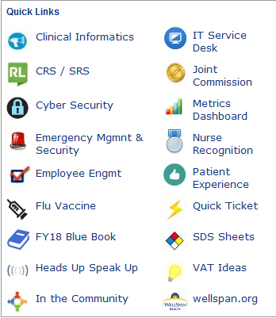
Patient Safety
Events are to be reported in the Safety Reporting System.
Link is on the INET home page.
Connects to PSRS (Pennsylvania’s Reporting System)

Slide 20

Safe Haven: PA Act 201 of 2002
Any parent may leave a newborn baby in the care of a hospital without being criminally liable, as long as the baby is no older than 28 days and is not harmed.
Any employee can accept; volunteers cannot.
Confirm that the parent is surrendering their infant to you.
Contact 911 and take the baby to GH Emergency Department for further care.
If there is an indication of abuse, also notify Police.

Slide 21
Adult Protective Services Act 70 of 2010
This law was passed to protect adults between 18 and 59 years of age who cannot protect themselves from abuse, neglect, exploitation, or abandonment due to a physical or mental disability.
Actions to take if you have reasonable cause to suspect that a person is a victim of abuse, neglect, exploitation or abandonment:
  Assure the individual’s health & safety
  REPORT
    Immediately make an oral report to the statewide Protective Services Hotline by calling 800-490-8505.
    In addition to reporting to the Protective Services Hotline, oral reports must be made to the Pennsylvania Department of Human Services/Adult Protective Services Division (by calling the mandatory abuse reporting line at 717-265-7887 and selecting option #3)
    And local law enforcement: only for suspected abuse or neglect involving sexual abuse, serious injury, serious bodily injury or if a death is suspicious.

Slide 22
Mandated Reporting
Mandated reporters are those people who are required by law to report suspected child abuse.
Mandated reporters are held to a higher standard of responsibility and may receive serious consequences for not reporting suspected abuse.
According to Pennsylvania’s Child Protective Services Law, people in these positions who are mandated to report child abuse include (but not limited to):
  A person licensed or certified to practice in any health-related field under the jurisdiction of the Department of State.
  An employee of a health care facility or provider licensed by the Department of Health, who is engaged in the admission, examination, care or treatment of individuals.

Slide 23

The Caring Behaviors
10/5 with Warm Greeting: eye contact & smile.
No Pass Zone: answer call bells of any patient.
Managing Up: speak positively of others.
No Venting: complain privately.

Slide 24
iCARE … Introduce, Confirm, Ask, Reassure, Educate
I = Introduce
Perform hand hygiene every time you walk into a patient’s room • Introduce yourself with your name, role and experience, as appropriate • Invite the patient to include his/her primary support person
C = Confirm
Confirm the patient’s name, why he/she is there, and expectations of any plans for the patient • Explain what you will be doing, why and how long it will take • Check first name, last name and date of birth • Talk while doing: explain each action you take and why in clear, non-clinical language to the patient
A = Ask
Ask clarifying questions • Ensure the patient understands instructions, procedures and such by having him/her paraphrase • Seek questions, concerns and issues from the patient and family
R = Reassure
Acknowledge and empathize with feelings and address concerns • Take appropriate action(s) • Manage up your colleagues
E = Educate
Explain specific instructions, next steps/teach Back • Teach back to confirm understanding by asking the patient to paraphrase the information you provided. • Remember: every patient, every time and ask, “What else?” • Offer additional help and support • Obtain feedback • Thank the patient for choosing us
• Perform hand hygiene every time you walk out of a patient’s room

Slide 25

Workplace Violence
Zero Tolerance: patient → staff, staff → patient, staff → staff, visitors → staff, visitors → patients, etc.
Categories:
  Threat
  Near Miss
  Actual Event with or without injury
Reporting
  All categories are to be reported
  SRS report must be filed for an event with injury

Slide 26
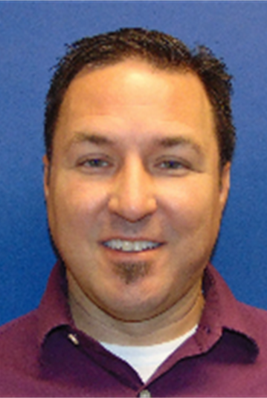

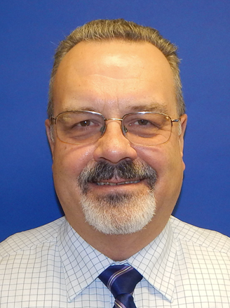
Facilities, Security and Life Safety
Matt Wentz – Manager of Engineering
George Steckert – Director of Safety/Security/Emergency Management

Slide 27

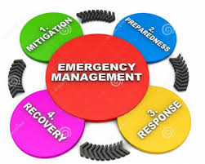
Emergency Preparedness
Preparedness is defined by DHS/FEMA as "a continuous cycle of planning, organizing, training, equipping, exercising, evaluating, and taking corrective action in an effort to ensure effective coordination during incident response." This cycle is one element of a broader National Preparedness System to prevent, respond to, and recover from natural disasters, acts of terrorism, and other disasters.
Notes:
Reduce Vulnerability, Advance Capacity & Capability, Manage Event, Restore Organization

Slide 28
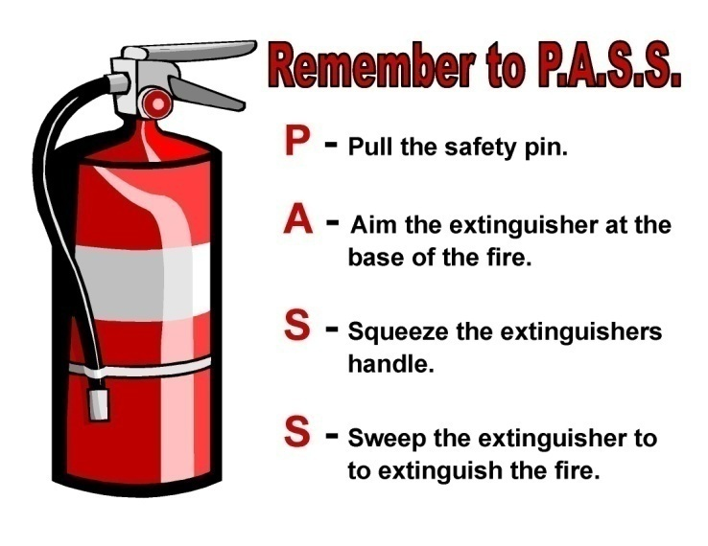
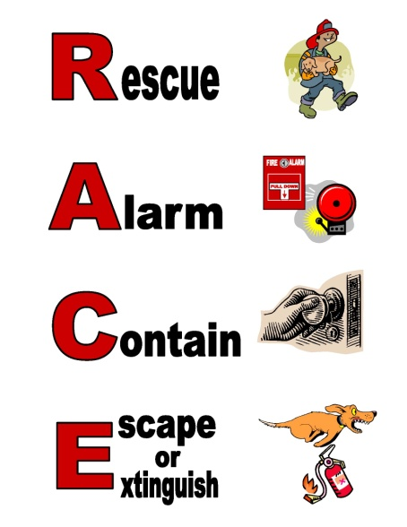
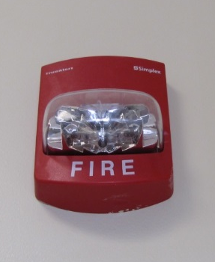
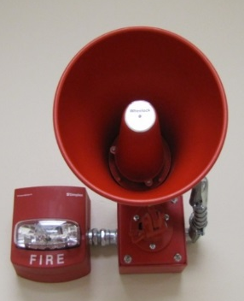
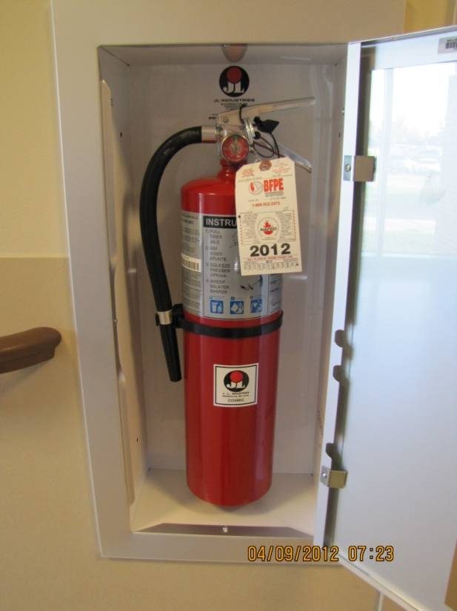
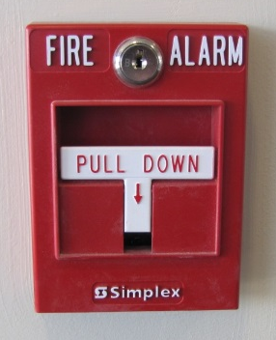
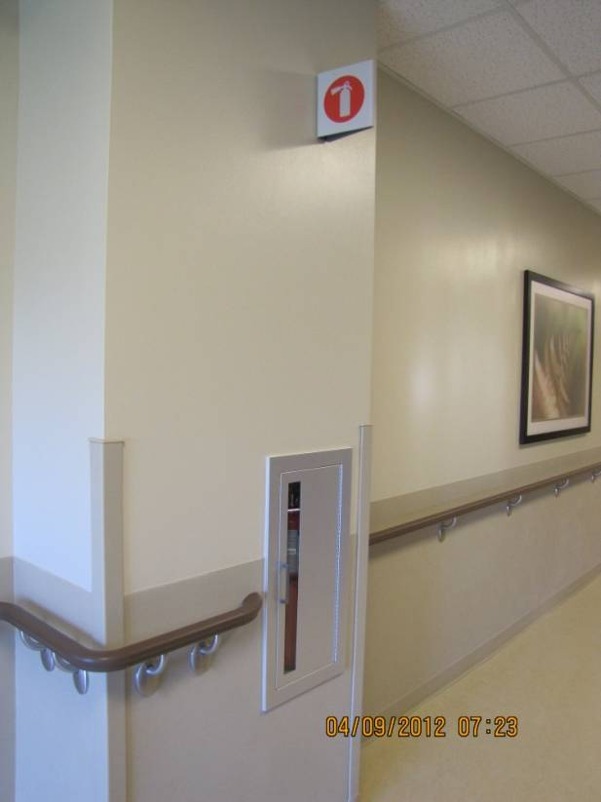
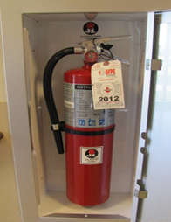
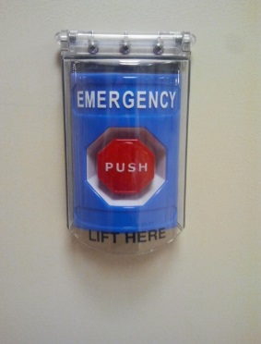
Fire Alarm Procedure
“Healthcare Occupancies” such as hospitals and nursing homes are constructed for staff and patients to remain in place, as most patients are not able to self-evacuate.
When the fire alarm activates in the hospital or one of our surgical and cancer centers, remain where you are. Do not pass-through doors that have closed. Certain staff are assigned to respond with fire extinguishers. Everyone else should remain in place until the “all clear” or other directions are announced over head.
When a fire alarm activates in an office setting, evacuation is the correct process.
Don’t forget R.A.C.E. and P.A.S.S. in either setting!

Slide 29

General Evacuation …
Do not wait for instructions if you are in imminent danger.
Move beyond at least one set of Smoke and Fire doors.
Use CLEARED magnets to identify rooms which have been evacuated.
Remember a “FIRE Alarm” does not mean to Evacuate, wait for the “Evacuation” announcement to do so if you are not in imminent danger.
EVAC Devices
Rally Point

Slide 30
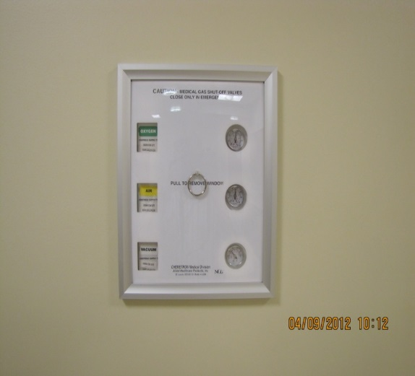
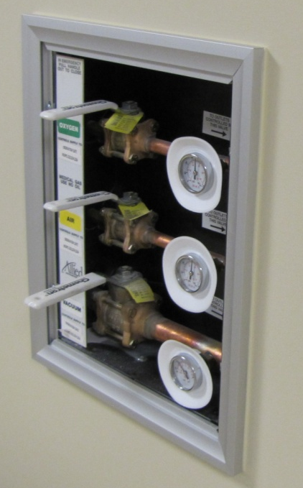
Medical Gas Zone Valves
Medgas ON, cover fits.
Medgas OFF, cover will not fit.
The Charge Nurse or Designee is responsible for Medical Gases in an emergency.
Know where the panels are in your work area
If you have any questions, contact Engineering at 337-4101.

Slide 31
Plain Language Emergency Notifications
NOTIFICATION LANGUAGE MEANING/SITUATION
Behavioral Emergency Response Team (BERT) Out of Control Person
Cardiac Arrest – ADULT Code Team Activation (18 years +)
Cardiac Arrest – PEDS Code Team Activation (31 days – 18 years)
Cardiac Arrest – NEONATAL Code Team Activation (0-30 days)
Emergency C-Section P1 C-Section
Evacuation Internal Evacuation
Fire Alarm Fire
Hazmat Chemical Spill Internal Spill
Mass Casualty Incident Mass Casualty Incident
Medical Emergency Non-Cardiac Arrest Emergency
Neonatal Emergency Neonatal Crisis at Delivery
Patient Decontamination Contaminated Person
Rapid Response Team Deteriorating Patient Condition – Help Team
Security Alert – Infant Abduction Infant Abduction (likely from Maternity)
Security Alert – Pediatric Abduction Child Abduction
Security Emergency – Armed Intruder Person Brandishing a Weapon
Security Emergency – Lockdown Facility Lockdown: Restricted Access Condition
Severe Weather – Tornado In Area Tornado
Stroke Stroke Team

Slide 32

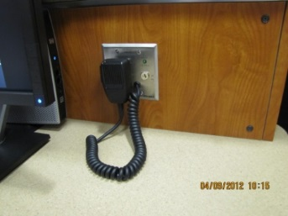
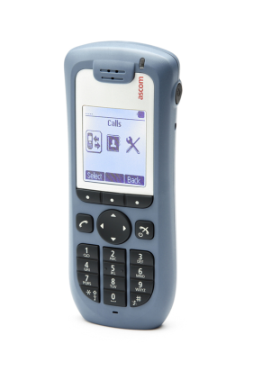
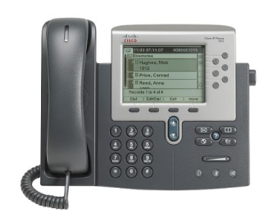
Communications
Avaya IP Phone (Desk Phone)
  Network Outage
  Power Outage
ASCOM Phone (Portable)
  Component Failure
  On Emergency Power
  Send and Receive outside calls
  Personal Distress
Emergency Overhead Public Address System
  On Emergency Power
  To be used only in emergencies
  Messages are Scripted
Emergency Phones
  Labeled as Power Failure Phone
Radios
When All else fails, RUNNERS

Slide 33
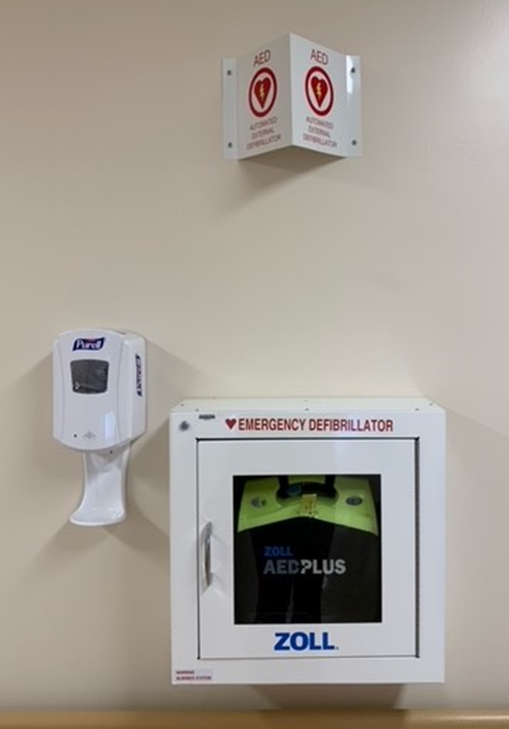
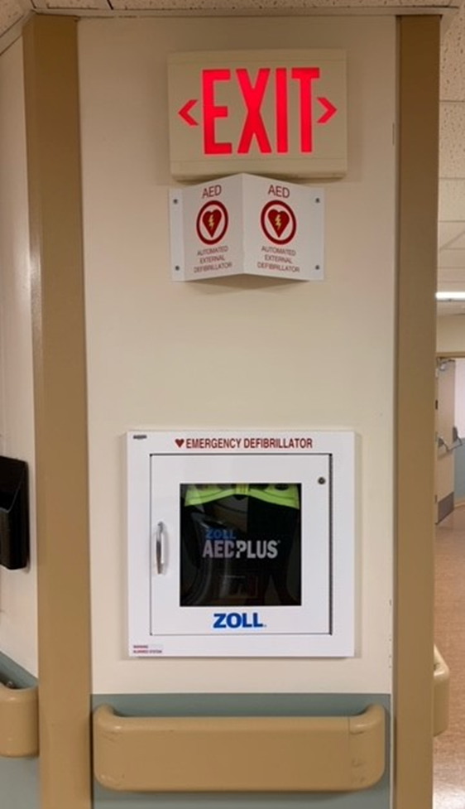
AEDs
A
B
There are 2 AEDs in the building placed where “Code Carts” are not available in a timely manner:
- By the community rooms (picture A).
- By the cafeteria (picture B).

Slide 34
Physical Environment/Safety
The goal is to provide a safe, inviting, functional and effective environment for patients, staff, and visitors by:
  Reducing and preventing environmental hazards and risks.
  Preventing accidents and injuries.
  Maintaining safe conditions.
  Methods used are
        Physical Environment/Safety Surveillance Rounds
          Twice a year for Clinical areas
          Once a year for Non-Clinical areas
  Security Rounding/Safety Rounding.
  Spot Reporting.
  Lean Daily Management.

Slide 35
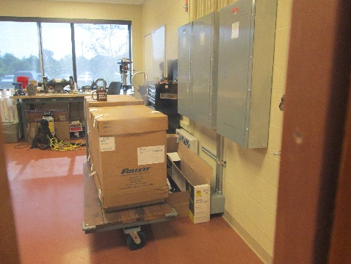
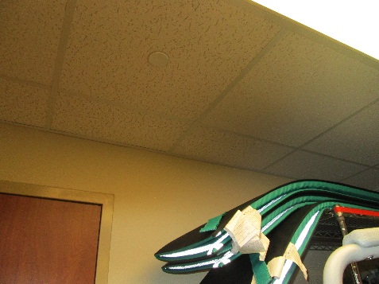
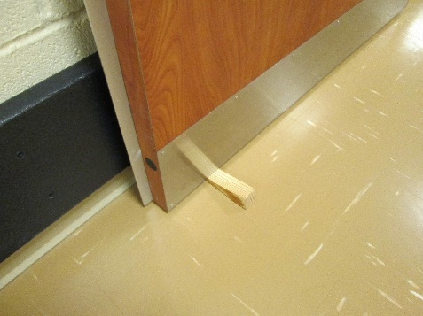
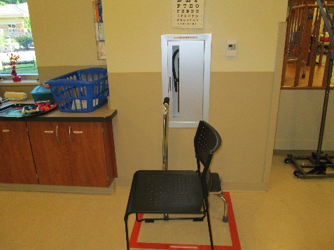
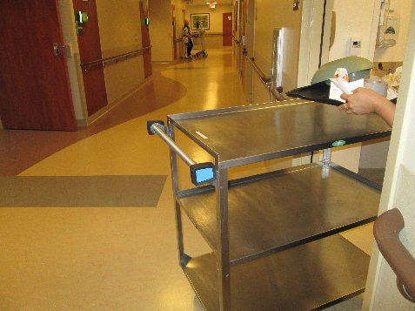
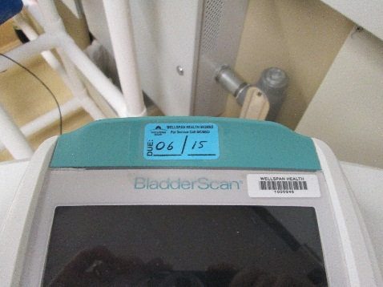
Top Physical Environment/Safety Items
Keep your area clean and clutter-free.
Keep overhead storage at least 18 inches below the sprinkler heads.
DO NOT prop open doors.
DO NOT block fire doors, pull stations or extinguishers.
Keep corridors and hallways free from obstructions.
Medical devices must be checked by Biomedical.
Personal plug-in devices must have a safety check
No items should be posted on fire doors
1
2
3
4
6
5

Slide 36

No Smoking Policy
Use of tobacco, and devices regulated as, or giving the appearance of, a tobacco product, will not be permitted in buildings, on property owned nor in vehicles owned by WellSpan Health. This policy applies to all employees, volunteers, medical staff, residents, students, vendors, contract personnel, visitors, and patients.

Slide 37
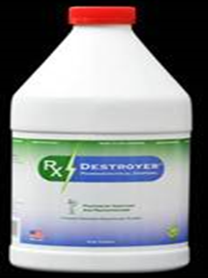
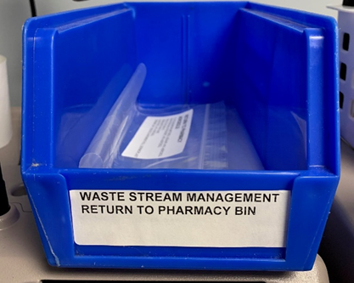
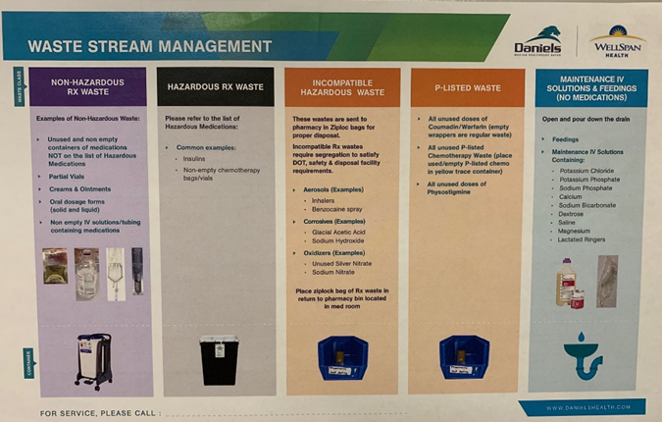
Waste Stream Management:
Disposal of Pharmaceutical Waste
The bins are not meant for:
Regular trash
Needles or other sharps
Controlled substances (Rx Destroyer)
Return to Pharmacy Bins:
P-Listed Waste
Aerosols
Corrosives: Sodium Hydroxide
Oxidizers: Unused Silver Nitrate

Slide 38
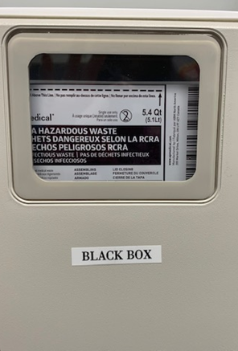
Waste Stream Management
Disposal of Pharmaceutical Waste
Black Box
The bins are stored in locked box located near the automated dispensing machines (ADS)
Insulin vials
Non-empty chemotherapy bag/vials

Slide 39
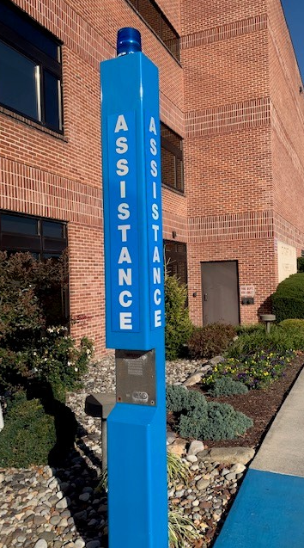
Security Management
Park in designated areas. Physician parking is labeled as such
There are various Emergency Assistance Call boxes located in the parking lots
Do not allow individuals to “piggyback” through access-controlled doors.
If someone is lost, give them directions to appropriately enter the facility or area.

Slide 40
Antimicrobial Stewardship & Opioid Usage

Slide 41

Antimicrobial Stewardship
Infectious Diseases Society of America (IDSA): “Coordinated interventions designed to improve and measure the appropriate use of [antimicrobial] agents by promoting the selection of the optimal drug regimen including dosing, duration of therapy, and route of administration.”

Slide 42
Antimicrobial Stewardship Initiatives at WellSpan Gettysburg Hospital
Use of system-approved order sets for common infectious disease states
System-wide quarterly review of antimicrobial utilization data/observation of trends
Pharmacy-driven initiatives:
Pharmacokinetic dosing (aminoglycosides, vancomycin)
Pharmacokinetic optimization of antimicrobials (extended-infusion piperacillin/tazobactam)
Renal dosing adjustments
Iv to PO conversion
Daily review of culture data for de-escalation opportunities
Antibiotic “time out” review 48-72 hours after antimicrobial order placed
Procalcitonin monitoring in lower respiratory tract infections

Slide 43
Opioid Reduction Initiative
WGH Opioid Reduction was started in FY2019 looking at:
Total Hip replacement
Total Knee replacement
The goal was to decrease the amount of MME prescribed at discharge by 5%
FY2020 WGH Opioid Reduction looked at:
Hernia surgeries
Lap chole surgeries
C-sections
Total Hip replacement
Total Knee replacement
The goal was to decrease the amount of MME prescribed at discharge by 10%
Wellspan Health system overall was able to reduce the total MME by 31% , leading to FY2021 opioid reduction initiative
WGH FY2021 Opioid reduction program includes:
Hernia surgeries
Lap chole surgeries
C-sections
Total Hip replacement
Total Knee replacement
2021: we are working at maintaining the progress that was achieved in FY 2020

Slide 44
Restraints & Seclusion

Slide 45

Physicians and other Licensed Independent Practitioners must have a working knowledge of the policy regarding the use of restraint and seclusion.
Wellspan Health Restraint Policy Link

Slide 46
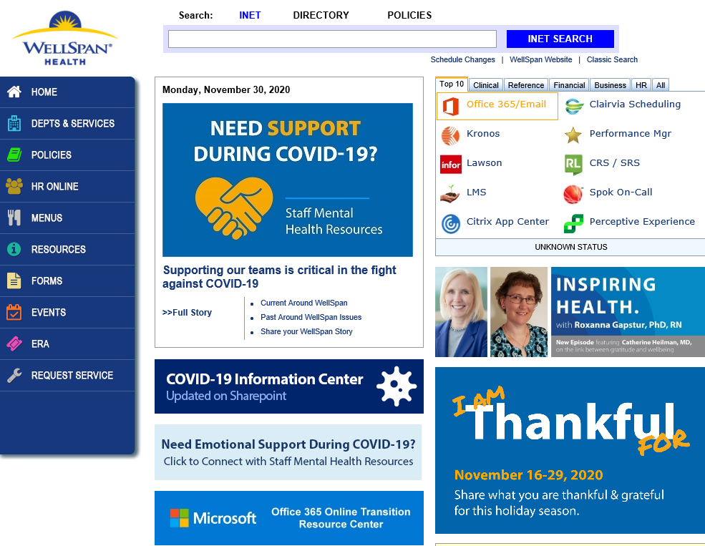
The Wellspan Health Restraint Policy can be found on the INET

Slide 47
Restraints
WellSpan is committed to reducing and minimizing the use of restraints. All patients have the right to be free from restraints that are not medically necessary or are used for purposes other than patient safety and benefits.
WellSpan uses restraint or seclusion only when it can be clinically justified or when warranted by patient behavior that threatens the physical safety of the patients, staff or others.
The use of restraints will be the last resort and used only when reasonably alternatives have been deemed ineffective and documenting it as unsuccessful.
Restraint or seclusion may not be used as punishment, discipline, staff retaliation means of coercion, for staff convenience, as a substitute for inadequate staffing or other inappropriate reasons such as solely based upon previous restraint necessity or a history of dangerous behavior

Slide 48
Restraint Use
*Alternatives to restraints should be attempted prior to initiation of restraints.
*only staff who have completed restraint education and have demonstrated competency, may apply restraints.
*Restraint or seclusion is discontinued at the earliest possible time regardless of the expiration
Alternative/Less Restrictive interventions to be attempted before restraint use
*If the situation is not emergent appropriate restraint alternatives must be tried before restraints are initiated
*Attempts use of alternative measures must be documented upon initiation of restraints
*Examples of alternative less restrictive interventions
- Personal alarms, bed alarms, and low beds
- Reorientation or redirection
- Distraction and diversional activities, such as folding/sorting activities, magazines, puzzles music,
TV drawing/ coloring
- Frequent opposite formation an reminders, moving patient closer to the nurse’s station
- Asking a family member to stay with patient

Slide 49
Alternative/Less Restrictive interventions to be attempted before
restraint use (cont.)…
*Examples of alternative less restrictive interventions
- Move to a quiet area
- Explain procedures
- Encourage physical exercise
- Toileting needs addressed
- De-escalation
Criteria for Restraint use
*Restraints should only be used to ensure the immediate physical safety of the patient, staff and others, after less restrictive interventions/alternatives have been determined to be ineffective.
*The following are appropriate criteria
- The patient is removing/attempting to remove invasive tubes/catheters that have been identified as integral to the patient's treatment plan (non-violent).
- Agitation or concerns for safety where the patient's behavior interferes with medical care or healing (non-violent).
- The patient present’s behavior or ideation has the potential to inflict bodily harm to self or others (violent/self- destructive).

Slide 50
Definitions:
Restraint: any manual method, physical or mechanical device, material, or equipment that immobilizes or reduces the ability of a patient to move his or her arms, legs, body, or head freely.
Chemical Restraint: a drug or medication used to mange the patient's behavior or restrict the patient's freedom of movement which is not a standard treatment or dosage for the patient’s condition.
Physical Hold for Forced Medication: the application of force to physically hold a patient, in order to administer a medication against the patient’s wishes, is considered restraint.
Physical Escort: a physical escort would include a “light” grasp to escort the patient to a desired location. If the patient can easily remove or escape the grasp, this would no be considered physical restraint.
Physical Holding: holding a patient in a manner that restricts the patient’s movement against the patient’s will is considered a restraint.
Seclusion: the involuntary confinement of a patient alone in a room or area from which the patient is
physically prevented from leaving. Seclusion maybe used only for the management of violent or
self-destructive behavior.

Slide 51
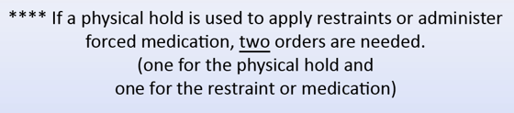
Types of Available Restraints
Mitts- All mitts are considered to be restraints since they limit full range of motions
Limb- (cloth, synthetic leather or nylon)- used for wrist and or ankle restraints
4-slide rails- if patient’s behavior warrants the use of 4 rails
Waist/ lap belt/lap buddy

Slide 52
What is Not a Restraint
Adaptive equipment used to promote functionality or independence ( such as postural supports, orthopedic
appliances, helmets) or temporary immobilization related to procedures/treatment.
Padded side rails for active seizure precautions.
Medical Immobilization-arm boards for Iv’s,
Adaptive Support- orthopedic appliances, braces, or other devices used for postural support
Specialty beds
Protective Devices- table top chairs, protective helmets, or other devices used for patient's safety issues or specific
Physical deficits not related to cognitive dysfunctions

Slide 53
Non-Violent Restraint Management
Non-violent restraint definition: necessary for patient’s well-being to receive effective treatment when less restrictive interventions have been ineffective.
- Example: A confused patient is attempting to remove his tracheostomy. The use of alternatives have been attempted and were unsuccessful. Restraints used in this situation would require order for non-violent behavior and care would follow those procedures.
Regulation requires a physician or license practitioner to order the restraint prior to or at the time of application.
A physician or other licensed practitioner must provide a face-to-face evaluation of the patient every 24 hours to assess the need for continued restraints.
Restraints are discontinued at the earliest possible time, regardless of the scheduled expiration of the order.

Slide 54
Violent or Self-Destructive Restraint Management
Violent or Self-Destructive Restraint Management : for sudden, severely aggressive or destructive behavior that
places the patient or others in imminent danger.
Example: a patient admitted to the medical floor for suicidal ideations and self-harm becomes agitated, combative, and verbally abusive and is attempting to hit staff. For the safety of the patient and others, the use of violent/self-destructive restraints may be necessary to mange the parietin's violent or self-destructive behavior.
Orders for restraints or seclusion for the management of violent or self-destructive behavior that jeopardizes the immediate physical safety of the patient, staff or others must be renewed within the following limits:
Every four(4) hours for adults
Every two (2) hours for ages 9-17
Every one(1) hour under the age of 9
Every 24 hours, a physician or other licensed provider, primarily responsible for the patients ongoing care,
sees and evaluates the patient before writing a new order.
A face-to-face assessment must be done within 1(one) hour of the initial application of restraints/seclusion.
The purpose of the evaluation is to determine whether there is a continued need for the intervention, factors that may have
contributed to the violent or self-destructive behavior, and whether the intervention was appropriate to address the violent
or self-destructive behavior.

Slide 55
Seclusion
Patients should only be secluded in emergency situations, as a means of ensuring their safety, when less
restrictive alternatives have been unsuccessful.
Physician or registered nurse who had demonstrated competency in the use of seclusion may initiate patient
seclusion. The door may be locked only with physician or nurse present.
Seclusion orders are limited to:
Every four(4) hours for adults
Every two (2) hours for ages 9-17
Every one(1) hour under the age of 9

Slide 56
LEAN/LDMS

Slide 57
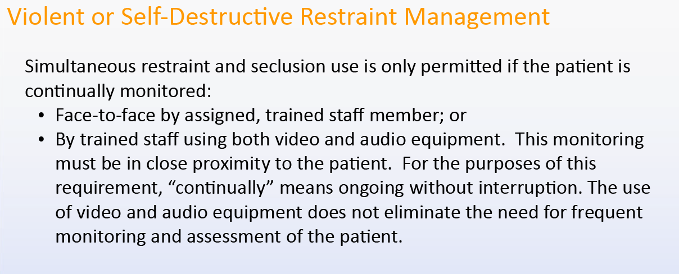

Slide 58
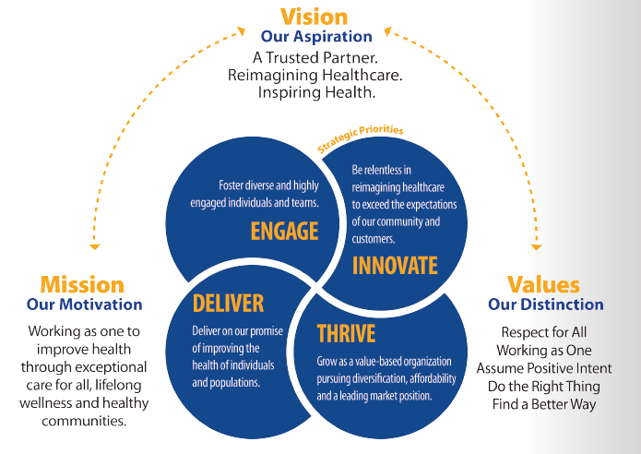
WellSpan Lean Daily Management System (LDMS)
20,000 Problem Solvers
“Doing More of What Matters, by Eliminating What Doesn’t”
Most organizations engage 10-20% of the workforce in problem solving/continuous improvement
Lean organizations want the entire organization actively engaged in continuous improvement: “20,000 Problem Solvers”
Leadership in a Lean organization is less focused on problem solving and more focused on building the problem solving capability of their teams.
Notes:
Photos of people doing this in transitions

Slide 59
Lean Daily Management System (LDMS)
The infrastructure that supports Continuous Improvement
Creates reliable and repeatable management practices that Align & Engage team members
A set of interconnected elements focused on developing teams of people to deliver continuously higher levels of value to our patients and other stakeholders
  Develop people to improve – Improve through developing people

Slide 60
Lean Daily Management System
Advisory Team
Internal and External responsibility to continue the entire system
Connect the Work of the Department to the System
See As a Team, Know as a Team, Act as a Team
Leader Standard Work
Maintains the Management Cycle
Develop People into People Developers
Build a Learning Organization
Constant Pressure (Inertia, The Whirlwind) to break apart
The Improvement Cycle
The purpose of LDMS
Develop people into problem solvers
Build a Learning Organization
Constant Pressure (Inertia, The Whirlwind) to break apart
Stat Sheet
Monthly Performance Review Mtg.
Develop Team
Capture OFIs
Reinforce priorities
Develop Team
Prioritize improvement
Improvement Huddle
Advisory Team
Leader Standard
Work
Engage team
Visually manage OFIs
Process Observation
Calendar
Staff Problem Solving
A3 Thinking
Shared ownership of results
Develop team
Capture OFIs
Process Standard Work
Standardized method to solve problems
Supports entire Lean Daily Mgmt. System
Makes System problems visible
Scorecard
Area Improvement Center
Makes problems (OFIs) visible
Makes problems (OFIs) visible
The Management Cycle
Supports the Improvement Cycle
Develop People into People Developers
Build a Learning Organization
Constant Pressure (Inertia, The Whirlwind) to break apart
Engage Team
Visually manage WIGs & Driver A3s

Slide 61
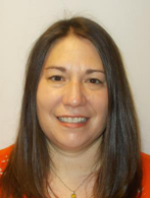
Jennifer Laughman- Infection Preventionist

Slide 62
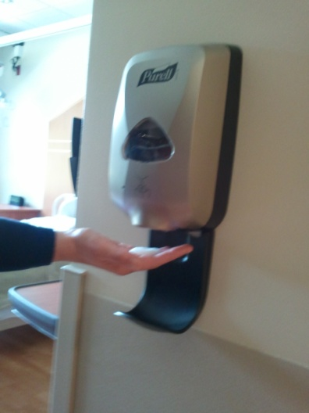
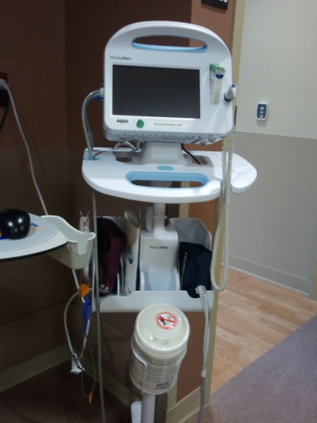

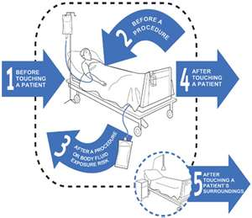

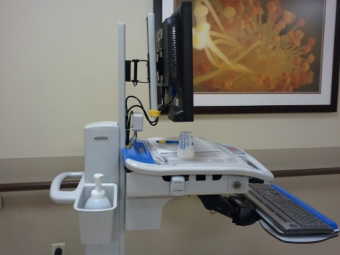
Infection Control Basics

Slide 63
Why Is Hand Hygiene So Important?
Thousands of people die every day around the world from infections acquired while receiving health care.
Hands are the main pathways of germ transmission during health care.
Hand hygiene is therefore the most important measure to avoid the transmission of harmful germs and prevent health care-associated infections.
Hand hygiene must be performed:
  To protect patients
  To protect healthcare workers
  To protect the environment

Slide 64
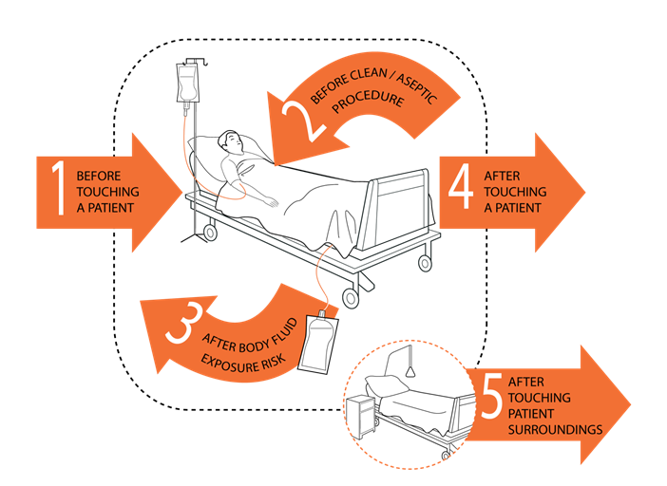
Hand Hygiene – Observations
Hand hygiene must be performed:
  Upon entering the patient’s room/before touching a patient
  Before a clean/aseptic procedure
  After body fluid exposure risk
  Upon exiting the patient's room/after touching the patient or environment
Glove use does not replace the need for hand hygiene
  Hand hygiene must be performed after removing gloves

Slide 65

Standard Precautions
Treat all patients as potentially infectious
Use standard precautions whenever there is a chance you’ll be exposed to:
  Blood
  Any other body fluids, secretions, or excretions
  Nonintact skin (broken skin)
  Mucous membranes
Respiratory etiquette

Slide 66

Respiratory Etiquette
Cover your mouth and nose when coughing or sneezing, preferably with a tissue.
Offer masks to persons who are coughing and encourage them to sit at least 3 feet away from others.
Perform hand hygiene after contact with respiratory secretions or contaminated objects.
This Photo by Unknown Author is licensed under CC BY-SA-NC

Slide 67




Dirty Patient Care Equipment/Items is a Source of Indirect Transmission of Microorganisms
Equipment that is contacting the patient and/or the patient environment should be properly cleaned between patients with a WellSpan approved disinfectant wipe between patients.

Slide 68

Think Infection Prevention
No lab finding or algorithm can replace the critical thinking and judgment of a health care professional.
There will be times that will seem appropriate to place enhanced precautions on a patient.
The patient’s team needs to be open and discuss concerns to ensure that our patients are safe.
When in doubt, do it!

Slide 69



Transmission-Based Precaution Signage

Slide 70

Contact Precautions
Perform hand hygiene
Gown and gloves MUST be worn when entering patient room for any reason.
Change gloves after having contact with material that may contain high concentrations of microorganisms.
Remove PPE before leaving patient room.
Perform hand hygiene immediately after glove removal

Slide 71

Droplet Precautions
Perform hand hygiene
Mask and Eye Protection
Must be worn to enter the room
Eyeglasses do not provide adequate protection
Wear a procedure mask with attached eye shield.
Patients must don a surgical mask and perform hand hygiene prior to leaving their room
Remove your PPE before leaving patient room
Perform hand hygiene immediately after PPE removal

Slide 72


Airborne Precautions
The patient must be placed in a negative pressure room.
Perform hand hygiene
A respirator (N95 or PAPR) must be worn to enter the room
Do not remove the respirator until after you have exited the room and closed the door.
Mask the patient with an isolation mask when leaving the room.

Slide 73


Stroke Program Core Team
Najeem Fazil Habibullah, MD
Stroke Medical Director
Susan Hunter, RN, MSN, AGCNS-BC, CCRN-K
Stroke & Heart Failure Program Coordinator

Slide 74
Stroke Alerts
Stroke is a Medical Emergency!
If your patient experiences any of the following symptoms:
  ♥Sudden numbness or weakness of the face, arm, or leg (especially on one side of the body)
  ♥Sudden confusion, trouble speaking, or trouble understanding speech
  ♥Sudden trouble seeing in one or both eyes
  ♥Sudden trouble walking, dizziness, or loss of balance or coordination
  ♥Sudden, severe headache with no known cause
Dial 66 for an inpatient stroke alert to be paged overhead. The Acute Stroke Team (a hospitalist, a CCU nurse, and the house supervisor) will respond to your area to expedite patient care.
ED Stroke Alerts are managed within the department by ED staff.

