Slide 1
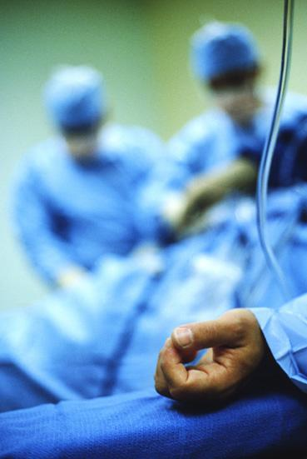

Operating room
Fire Safety

Slide 2
Purpose of this module
The response to an Operating Room (OR) fire should be initiated within the second of discovery.
Fire prevention is a shared responsibility of the entire surgical team. The surgical team needs to help each individual member of the team to carry out his or her responsibility.
DNV requires annual WSRH operating room specific fire safety education.

Slide 3
Fire and/or Evacuation Policy
The WSRH has a Fire and/or Evacuation Policy for Perioperative Service
This applies to all staff within perioperative services
The policy can be found on the WSRH Policy Repository

Slide 4
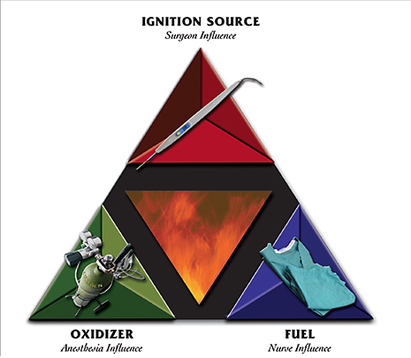
AORN Fire triangle
Fire is a risk to both patients and personnel in the OR because all three elements of the fire triangle that are necessary for a fire (fuel, oxidizer, ignition source) are present.
Source: Guidelines for Perioperative Pracitce 2018, AORN: https://www.r2library.com/resource/detail/0939583046/ch0010s0150#goto=ch0010s0150fg0023

Slide 5
Fire Risk Assessment in OR
Allow prep dry time of at least 3 minutes
  Which includes 10 minutes for hairy areas
Document sources of ignition in the operating room
Full acknowledgement and documentation of fire safety risks during time out by surgical team

Slide 6
Evacuation Readiness Best Practices
Do not block gas shut-off valves
Do not block hallways; keep clear
Do not block fire doors; keep clear

Slide 7
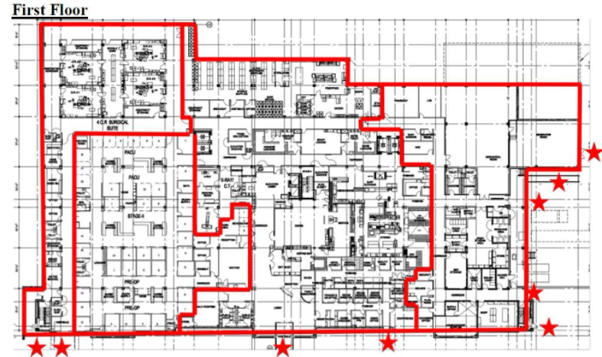
Fire Evacuation Route from OR
Utilize discharge hallway
Relocation or evacuation will always be away from the area affected by the fire emergency.
ORs

Slide 8
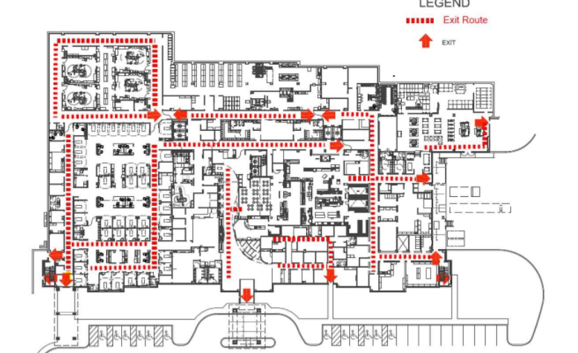
Exit Routes
ORs

Slide 9
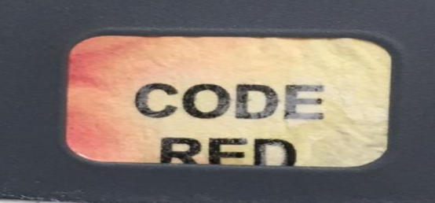
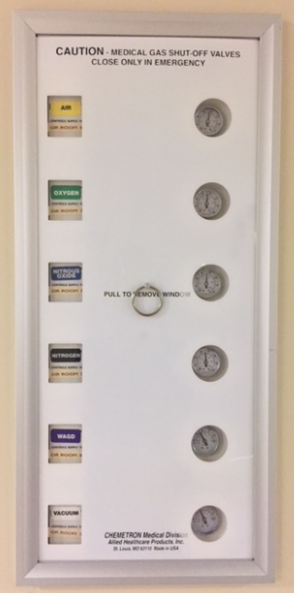
Individual Duties: Circulating Nurse
Activate fire alarm by pushing “Code Red” in room
Provide additional non-flammable liquids & drapes to smother the fire
Turn off gas supplies as directed by Anesthesia
Prepare for evacuation if necessary
  Obtain supplies for evacuation such as fire extinguishers, drapes, portable monitor, and available team members
If equipment is smoking, turn off and disconnect power source
Report event to Risk Management and complete Safety Report
Reset fire code alarm

Slide 10
Individual Duties: Scrub Person
Remove drapes/burning material
Douse with water from table
Protect the patient

Slide 11
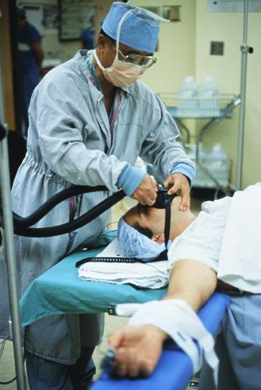
Individual Duties: Anesthesia Provider
Stop flow of breathing gases to patient
Switch to portable gases
Direct OR personnel to turn off gas supplies

Slide 12
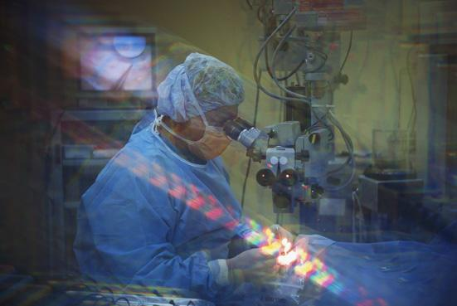
Individual Duties: Surgeon
Stay with patient
Control hemorrhage
Prepare for evacuation if necessary

Slide 13
Individual Duties: OR Assistant Nurse Manager and OR Charge Nurse
Code red will send alert to all of working circulators of OR fire and location on ASCOM phones. Code red will automatically notify facilities, security, and the Perioperative Nurse Manager of the fire and the location
OR desk will act as command post.
Direct outside help as necessary by communicating needs (traffic controller)
Communicate with other OR rooms as needed

Slide 14

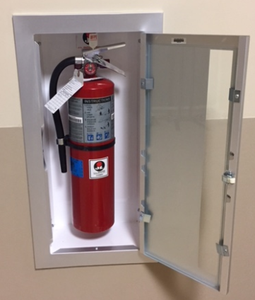
Individual Duties: Ancillary Personnel
Clear hallways
Clear room
Post “ALL CLEAR” signs as appropriate
Assist with moving
Obtain fire extinguishers
  Located by Room 3, Room 4, and in the main OR hallway by the door to the core

Slide 15
Individual Duties: Receptionist/Surgical Waiting
Reassure family as necessary
Surgical waiting area and offices will be checked and cleared by the receptionist

Slide 16
Individual Duties: PACU/Pre-Op Techs
Nursing techs will split the Pre-Op Unit and clear any empty rooms by checking the room, shutting the door, and placing an orange cone outside of the room. Orange cones are located in each room.
Once the empty rooms have been cleared, nursing techs will assist nursing staff with any assigned tasks

Slide 17
Individual Duties: Perianesthesia Assistant Nurse Manager or Perianesthesia Charge Nurse
Perianesthesia Assistant Nurse Manager or Perianesthesia Charge Nurse will keep open communication with all other units in reference to fire plan and help Perioperative Team as needed

Slide 18
Individual Duties: PACU/Pre-Op Staff Nurses
Staff nurses will direct family members and visitors to exit the building
Staff nurses will reconnect patients using wall O2 to the portable O2 tank under the stretcher

Slide 19
All Perioperative Staff
Will remain within the fire wall until the fire alarm is clear
If a shelter in place/evacuation is called, all staff will assist in the evacuation of all patients in the safest manner possible

Slide 20
For a fire in an adjacent or nearby room while surgery is in progress
Seal off room with wet blankets
Disconnect all electrical equipment

Slide 21
Thank you
Working as One

